Slide 1
Web Design & Development Y2/Sem 1
Week 4. bootstrap Tutorial

Slide 2
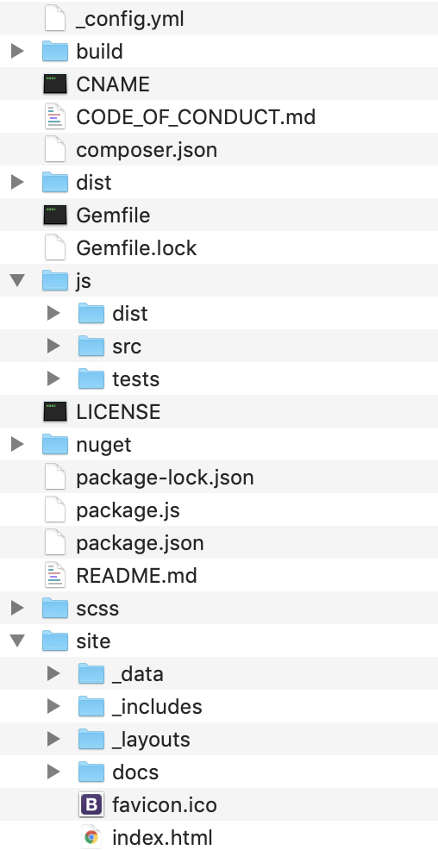
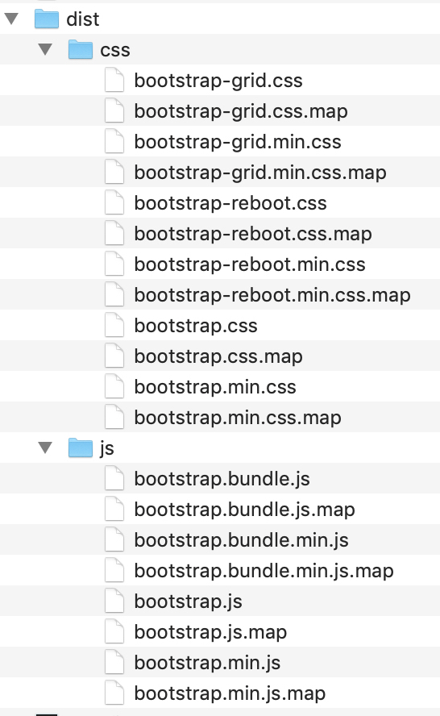
Install (getbootstrap.com)
min files - unnecessary chars removed = smaller, faster files
min files - unnecessary chars removed = smaller, faster files
Source version
Compiled version
3

Slide 3
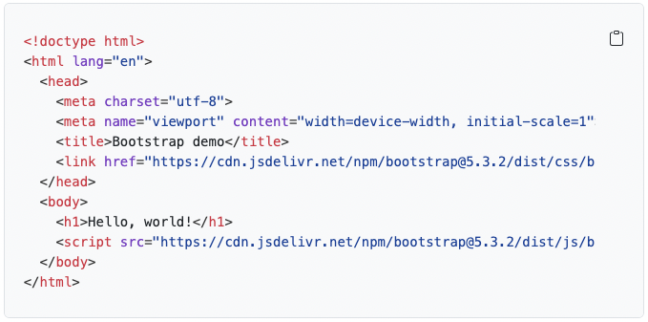
Basic template (loaded from CDN)

Slide 4


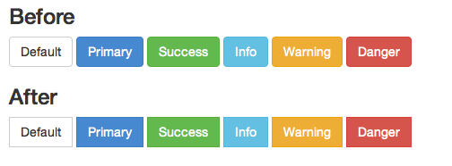
Customising Bootstrap
Add custom.css - never modify core files!

Slide 5
Bootstrap examples
Familiarise yourself with these - I do not want to hear “I did not know about those”
Goto https://getbootstrap.com/docs/ - to find lots of examples/sample code
Getting Started – installing and getting up and running
Customise – overriding defaults using SASS
Layout – Breakpoints, containers, grid, columns
Content – typography, images, tables
Forms – input, select, checkboxes, radio, labels
Components – visual artifacts – buttons, carousels, dropdowns, acordions
Helpers – miscellaneous advanced topics
Utilities
Suggested Approach
Get familiar initially with with the base content components – the cheatsheet (https://getbootstrap.com/docs/5.3/examples/cheatsheet/) should be a bookmark in your browser
Then follow up with container, grid and columns

